Slide 1
UET PESHAWAR
To Investigate The Effects of Talc on Ceramic Floor Tiles Glaze as Opacifier
Presented By:
Engr. Murtaza Khan
Research Advisor:
Dr. Mohammad Imran Ahmad
DEPARTMENT OF CHEMICAL ENGINEERING UET, PESHAWAR

Slide 2

Table of Contents
Introduction
Problem Statement
Objectives
Materials and Method
Results and discussion
Conclusion

Slide 3
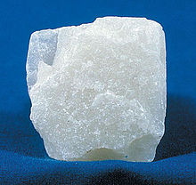
Introduction
Talc
Formula: Mg₃Si₄O₁₀(OH)₂
Alternate Names: Magnesium Silicate, Steatite, French Chalk, Hydrated talc
The most common mineral in the class of silicates and the softest of all minerals.
Chandra et al.,2004. Sintering characteristics of talc in the presence of phosphatic and alkali carbonate sintering activators. Ceramics international, 30(5), pp.643-652.

Slide 4
Problem Statement
The whiteness of ceramic glaze is achieved by various opacifying agents. Zirconium silicate is predominantly used as opacifier but it is expensive.
Higher amount of Zirconium Silicate may not ensure desire quality.
Therefore, it is needed to investigate economical alternatives for zirconium silicates such as talc.
Magagnin, D., dos Santos, C.M.F., Wanderlind, A., Jiusti, J. and De Noni, A., 2014. Effect of kaolinite, illite and talc on the processing properties and mullite content of porcelain stoneware tiles. Materials Science and Engineering: A, 618, pp.533-539.

Slide 5
Objectives
To investigate the effect of talc on the physical-mechanical properties of Ceramic Glaze
To make ceramic glaze more economical
To utilize regional mines of talc

Slide 6
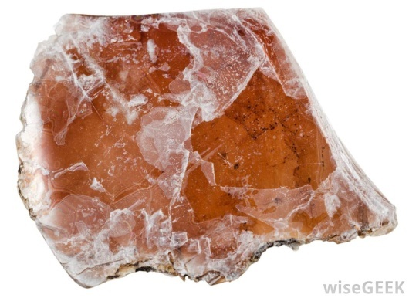
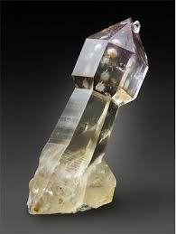
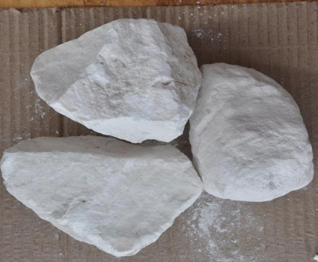

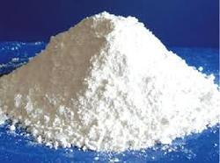
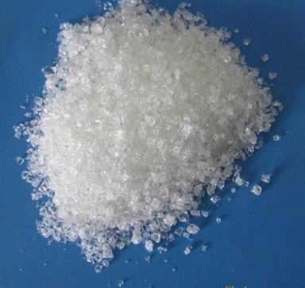
Materials and Method
The raw materials used for the samples preparation were potash feldspar, China clay, commercial frit, quartz, talc, and Zirconium silicate.
Feldspar
Quartz
Talc
China clay
Zirconium Silicate
Frit

Slide 7
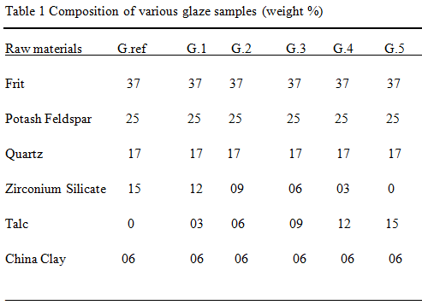
Composition of various glaze samples (weight %)

Slide 8
Schematic of experimental method
The block diagram shows process for producing glazed floor tiles:
Wet grinding
Preparation of sample
Composition
Drying
Spraying
Tray dryer
Firing
Roller kiln
1120-1150◦C

Slide 9
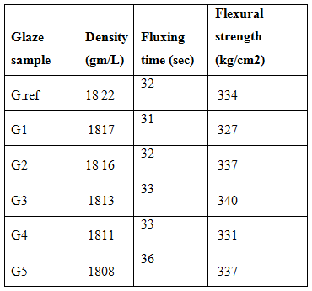
Results and Discussion
Properties of glazed floor tiles

Slide 10
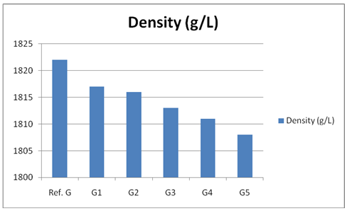
Density of glazed floor tiles samples
Talc: 0% 3% 6% 9% 12% 15%

Slide 11
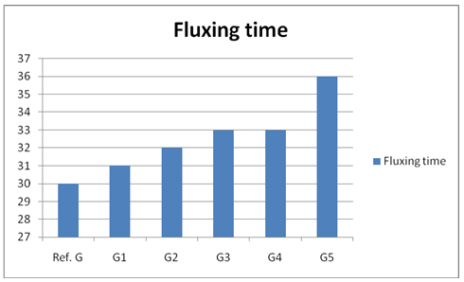
Fluxing time of glazed floor tile samples
Talc: 0% 3% 6% 9% 12% 15%

Slide 12
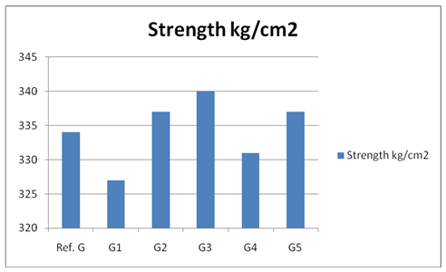
Flexural strength (kg/cm2) of glazed floor tiles samples
Talc: 0% 3% 6% 9% 12% 15%

Slide 13
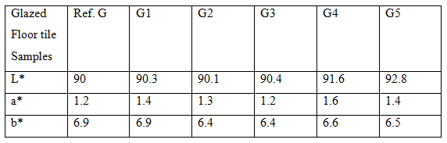
Color index of glazed floor tiles samples

Slide 14
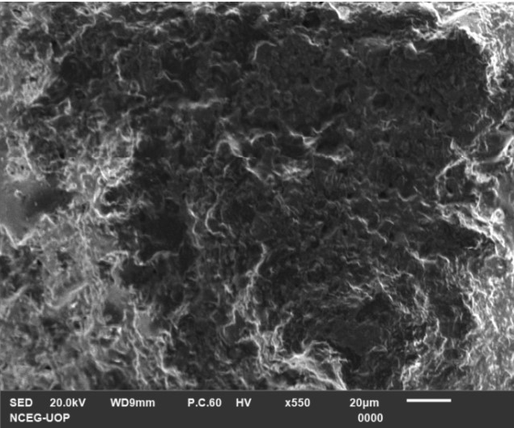
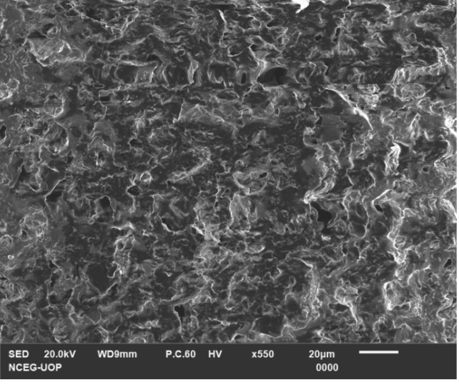
SEM Analysis
G. Ref
G. 5

Slide 15
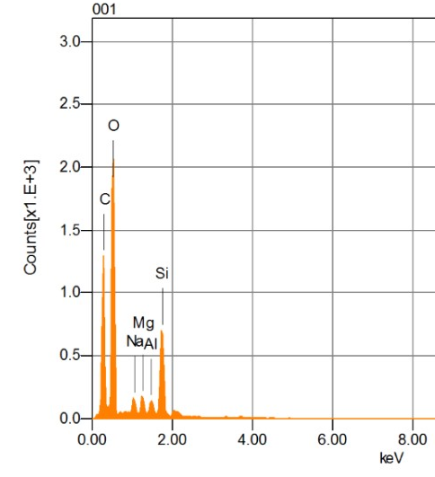
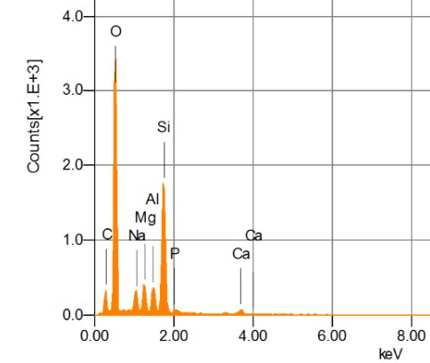
EDX Analysis
G. Ref
G. 5

Slide 16
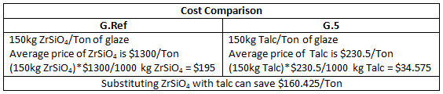
Cost Analysis
Source: Alibaba.com

Slide 17
Conclusions
Increasing the amount of talc by substituting Zirconium silicate, decreases the density.
Fluxing time increased indicating increase in viscosity.
Flexural strength varied but remained in acceptable limits as strength depends on composition of ceramic body.
The color index indicated that same degree of whiteness can be achieved by replacing Zirconium silicate with talc.

Slide 18


